Slide 1
Legal Netlink Alliance Fall Meeting September 18-21, 2024 Greensboro, North Carolina

Slide 2
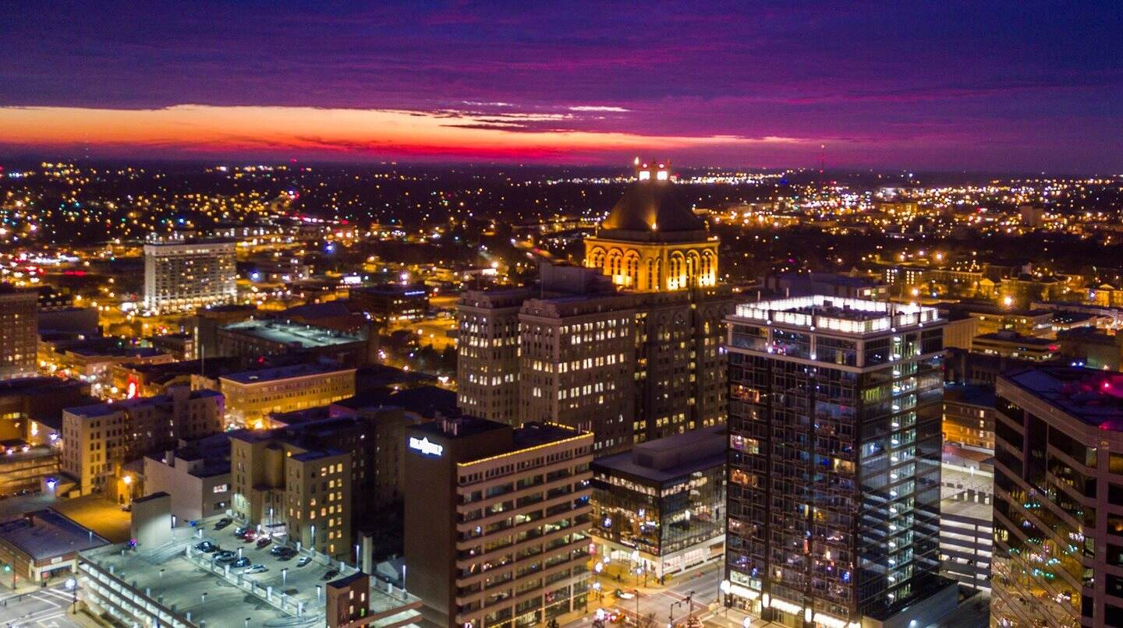
Greensboro, North Carolina

Slide 3
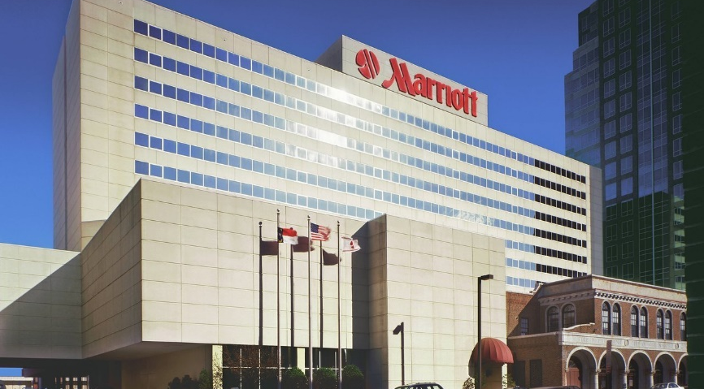
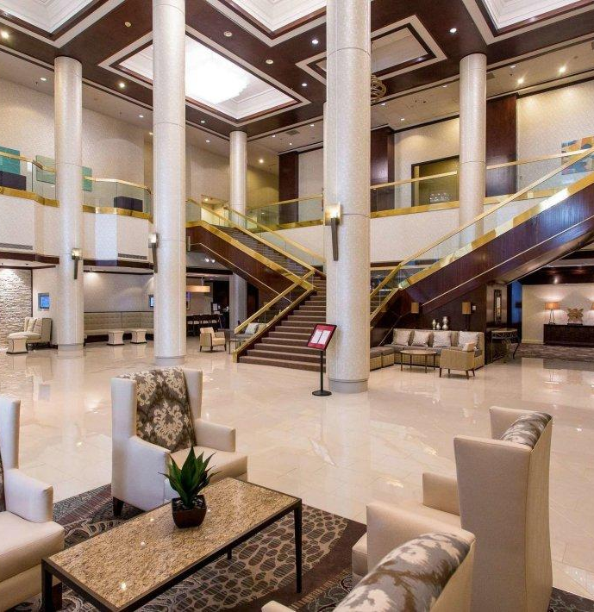
Host Hotel: Marriott Greensboro Downtown

Slide 4
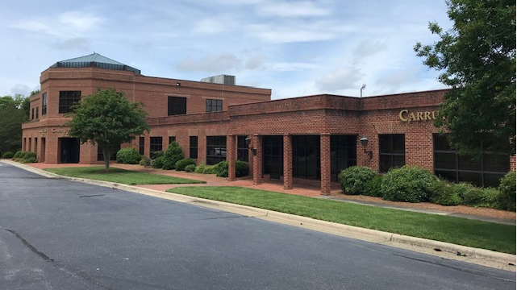
Evening Welcome Reception – Wednesday, Sept. 18 Lunch/Opening Session - Thursday, Sept. 19 Carruthers & Roth, P.A.

Slide 5
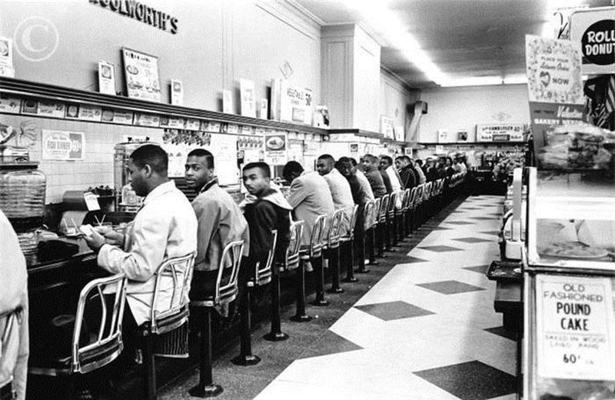
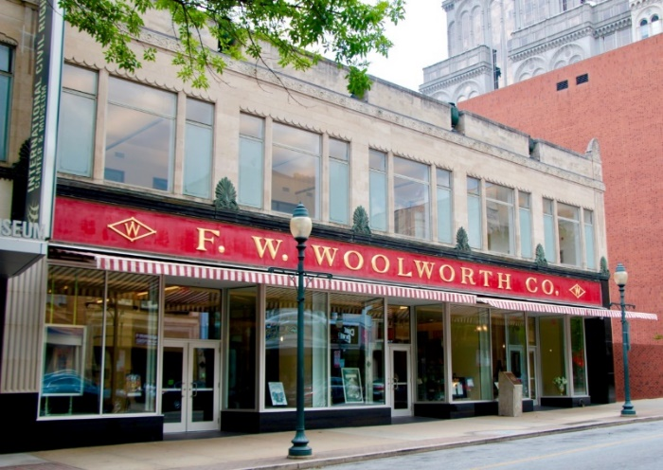
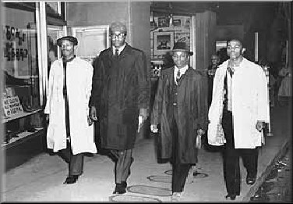
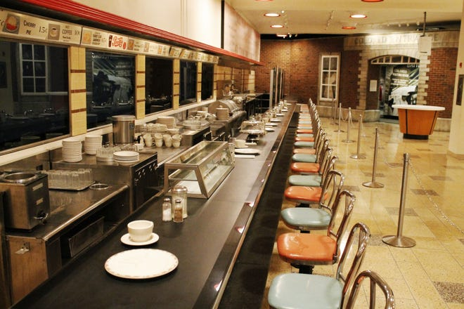

Slide 6
The Business Program

Slide 7
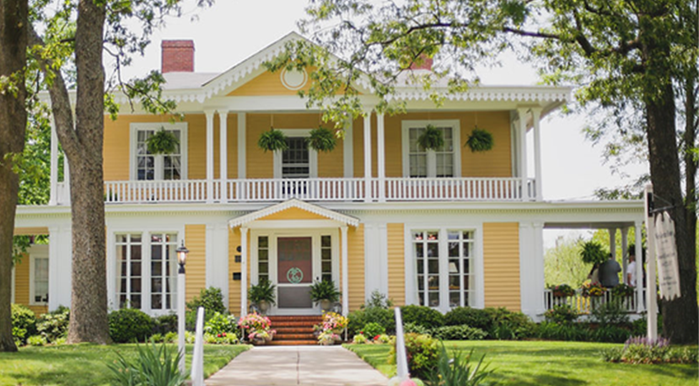
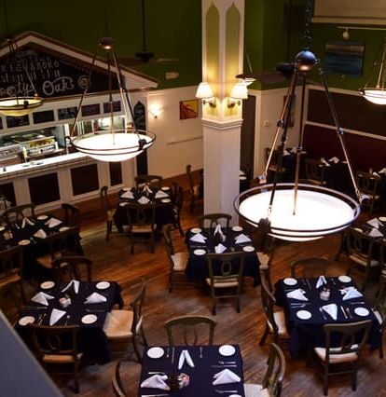
Dinners

Slide 8
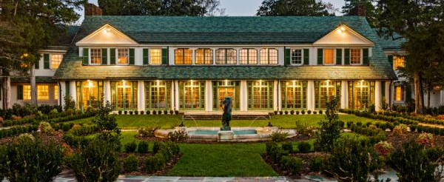
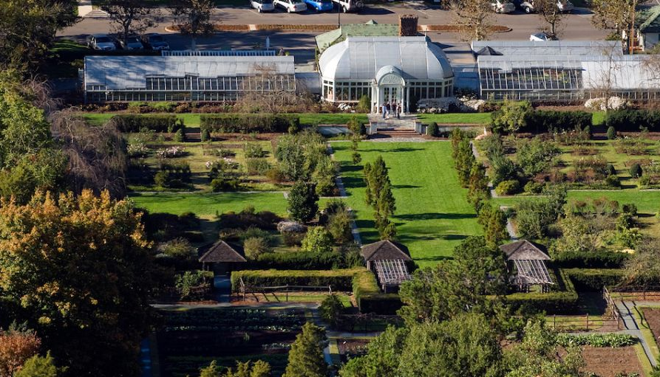
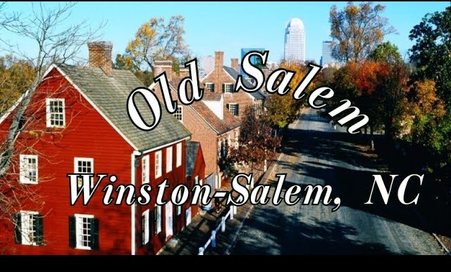

Slide 9
Area Attractions

Slide 10
Within the Triad (Greensboro, Winston-Salem, and High Point):
International Civil Rights Center & Museum (birthplace of the Sit In Movement)
Guilford National Military Park (Revolutionary War battlefield and museum)
Greensboro Science Center (accredited zoo)
Tanger Performing Arts Center (Mamma Mia!)
Weatherspoon Art Museum
Old Salem (historic community originally settled as a Moravian community in 1766)
Reynolda House Museum of American Art, Gardens, and Village
High Point Furniture Showrooms

Slide 11
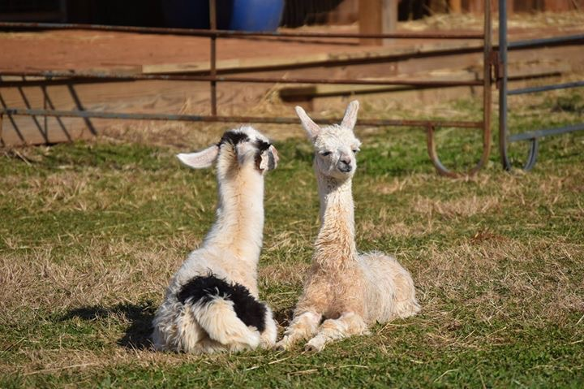
Within an hour of Greensboro:
Renowned Universities:
UNC Chapel Hill Duke University Wake Forest University NC State University
Seagrove (handmade pottery capital of the United States)
North Carolina Zoo
Great state parks
Craft Breweries, Wineries, and Distilleries

Slide 12
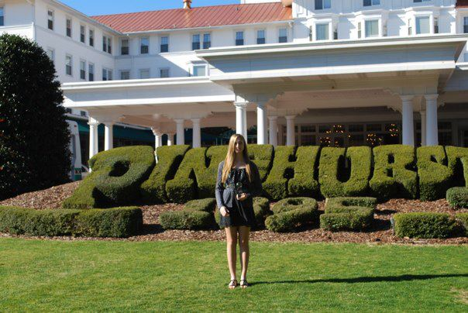
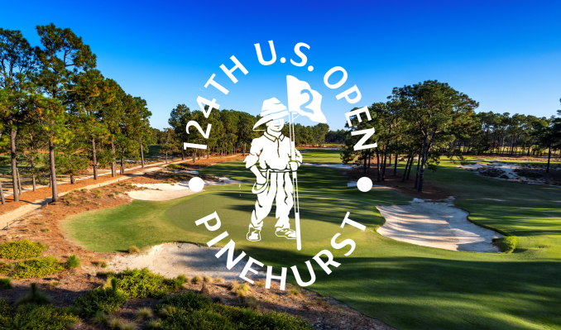
Within 90 minutes of Greenbsoro
Pinehurst Golf Resort (home of the 2024 U.S. Open)
Charlotte and its attractions
Raleigh and its attractions

Slide 13
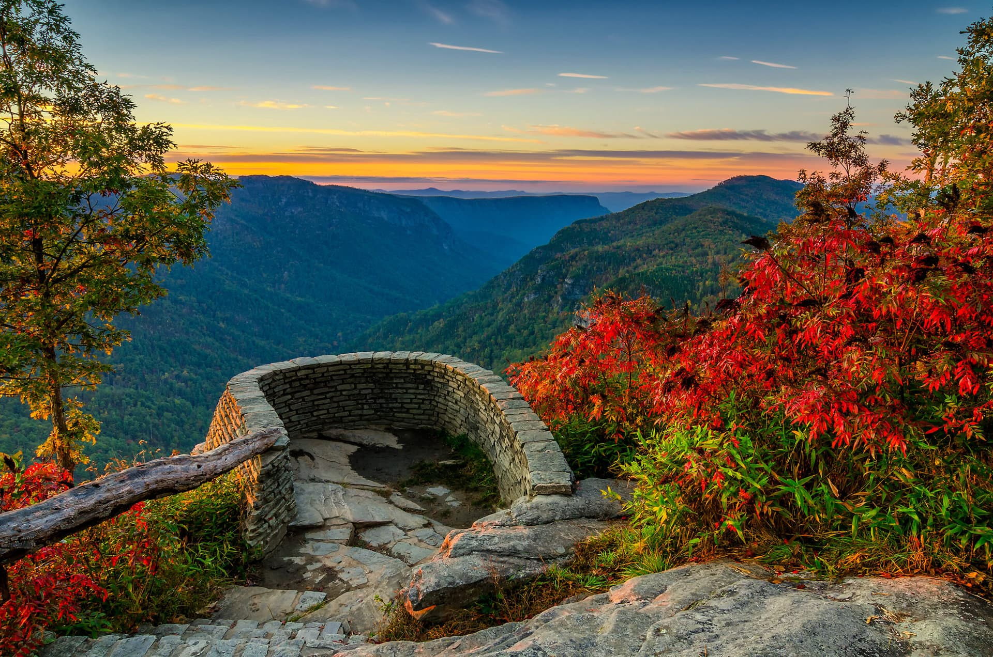
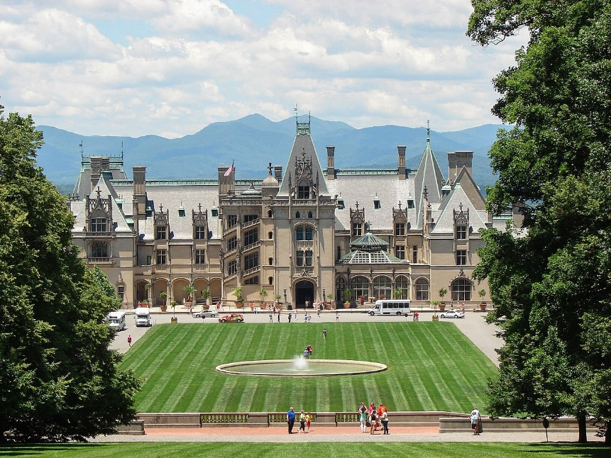
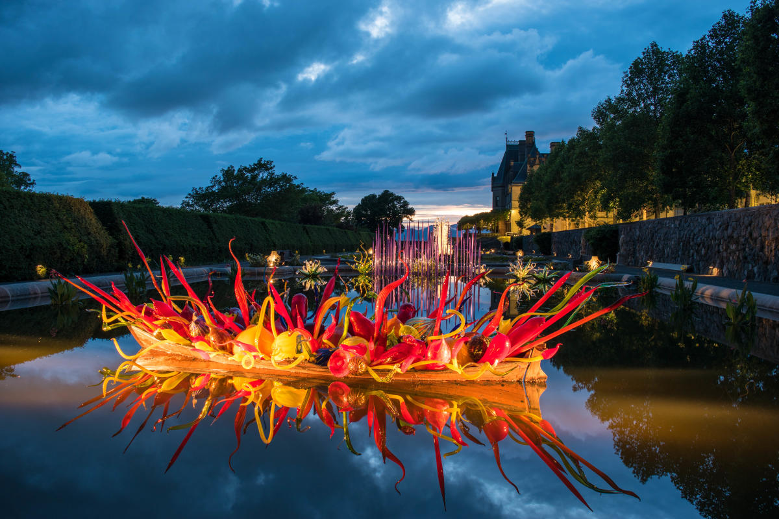
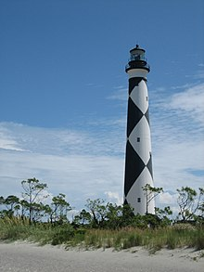
Within Two Hours of Greensboro:
Blue Ridge Parkway
Boone, NC
Blowing Rock
More Craft Breweries and Wineries
Within Three Hours of Greensboro:
Asheville (Biltmore Estate, Grove Park Inn, great restaurants, breweries, hiking, scenery, and more)
Grandfather Mountain
North Carolina Beaches

Slide 14
Questions? Contact Mike Allen mja@crlaw.com 336-478-1190 See You in September!

